Slide 1

SC DIGITAL MARKETING SERVICES
SEO or Search Engine Optimization Portfolio

Slide 2
SC DIGITAL MARKETING SERVICES SEO COMPONENTS
We at SC Digital Marketing Services a Leading Digital Marketing Services in Mumbai offer you a comprehensive SEO or Search Engine Optimization service that includes the following components:
a. On- Page SEO: Title Tag, Meta Description, Meta Keywords, URL Optimization, Header Tags, Content Optimization, Image Optimization, Internal Linking, External Linking, Page Speed & Core Web Vitals, Mobile Friendliness, Schema Markup, Canonical Tags, User Experience, and Sitemap & Robots.txt
b. Technical SEO: Website Crawling & Indexing, Site Architecture, URL Structure, Website Speed Optimization, Mobile Optimization, HTTPS / Website Security, Internal Linking & Crawl Depth, Canonicalization, Structured Data (Schema Markup), Core Web Vitals, Log File Analysis, Duplicate Content Control, Multilingual / International SEO, Redirect Management, Error Handling, Analytics & Tracking Setup, and Server & Hosting Optimization

Slide 3
SC DIGITAL MARKETING SERVICES SEO COMPONENTS CONTD
c. Off-Page Activities: Link Building, Social Media Engagement, Content Marketing, Press Release Submission, Q&A Participation, Image & Video Submission, Influencer & Blogger Outreach, and Forum & Community Participation
d. Local SEO: Google My Business (GMB) Optimization, NAP Consistency (Name, Address, Phone), Local Citations, Localized Website Content, Schema Markup (Local Business Schema), Online Reviews & Ratings, Local Backlinks, Map & Direction Integration, Mobile Optimization, Social Media Local Presence, Local Keyword Optimization, Local Landing Pages (for multi-location businesses)

Slide 4
SC DIGITAL MARKETING SERVICES SEO COMPONENTS CONTD
Content Marketing: SEO optimized Blogs, Product Pages, Press Releases, Guest Posting Content, GMB Content, Reviews. 4 Blogs per Week. Total of 12 per month. Content Strategy included Pillar and Cluster and Content Marketing Funnel

Slide 5
SC DIGITAL MARKETING SERVICES GEO COMPONENTS
With the rise of the latest AI Search Engine Tools in 2025 like ChatGPT, Perplexity, and Gemini it has become essential for you to do AI SEO. We at SC Digital Marketing Services | Leading Generative Engine Optimization Services in India offer you the following components given below:
a. AI-Readable Content Structure
b. Semantic Keyword Optimization
c. E-E-A-T Alignment
d. Structured Data & Schema Integration
e. Conversational Content Design
f. Content Depth & Contextual Relevance
g. User Interaction & Engagement Signals
h. Source Credibility & Citations
i. Page Performance & Accessibility
J. Voice & Conversational Search Optimization

Slide 6

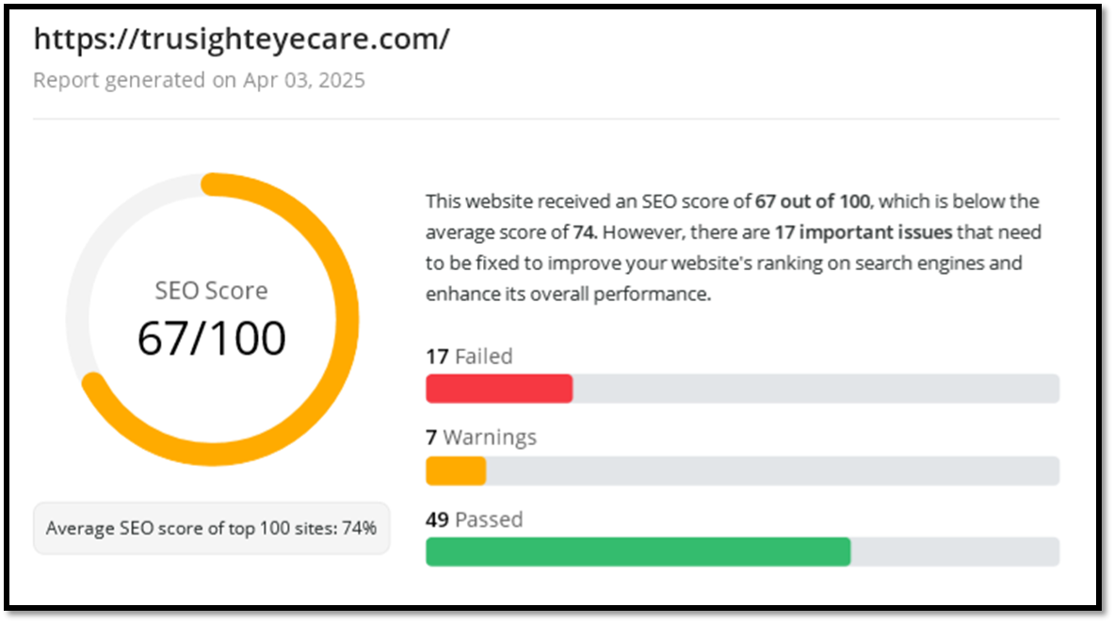
SC DIGITAL MARKETING SERVICES SEO WORK PORTFOLIO
SEO Site Audit of Trusight Eyecare Before Service

Slide 7
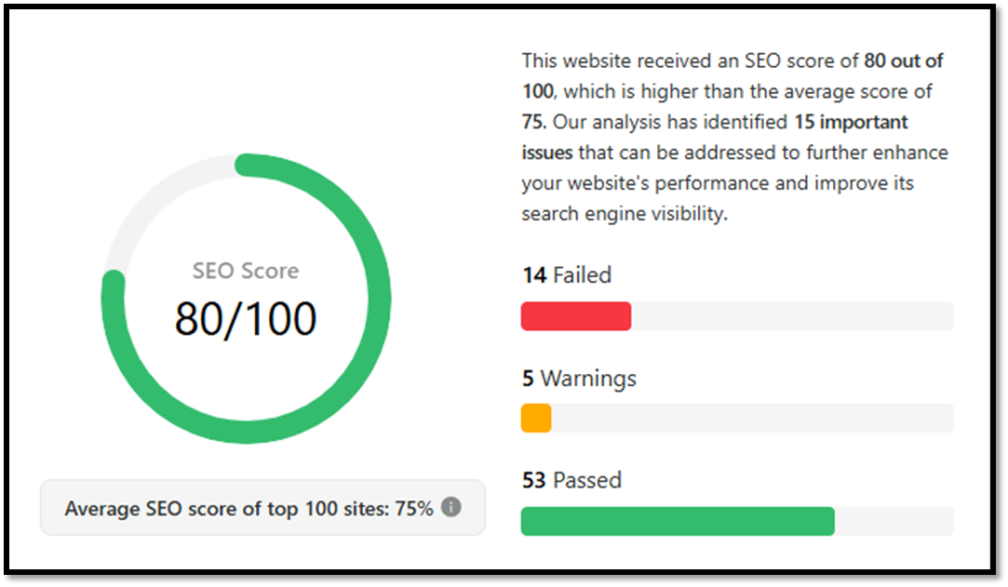
SC DIGITAL MARKETING SERVICES SEO WORK PORTFOLIO
SEO Site Audit of Trusight Eyecare Service After

Slide 8
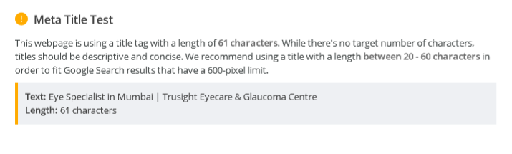
SC DIGITAL MARKETING SERVICES SEO WORK PORTFOLIO
Meta Title and Description Before

Slide 9
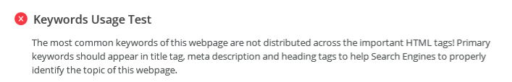
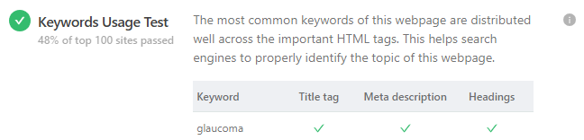
SC DIGITAL MARKETING SERVICES SEO WORK PORTFOLIO
Keywords Usage Test Before and After

Slide 10

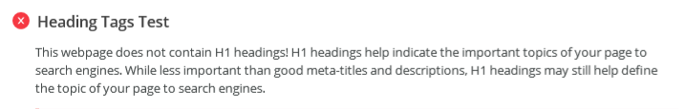
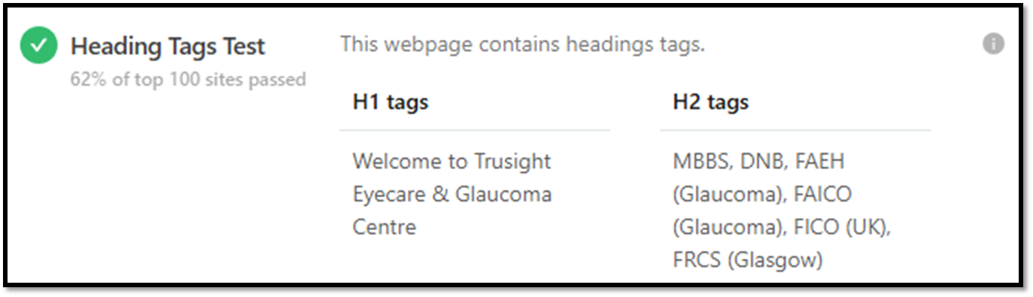
SC DIGITAL MARKETING SERVICES SEO WORK PORTFOLIO
Heading Tag Test Before and After

Slide 11
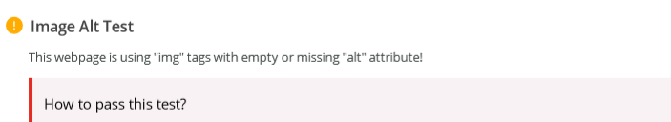

SC DIGITAL MARKETING SERVICES SEO WORK PORTFOLIO
Site Loading Speed Test Before and After

Slide 12

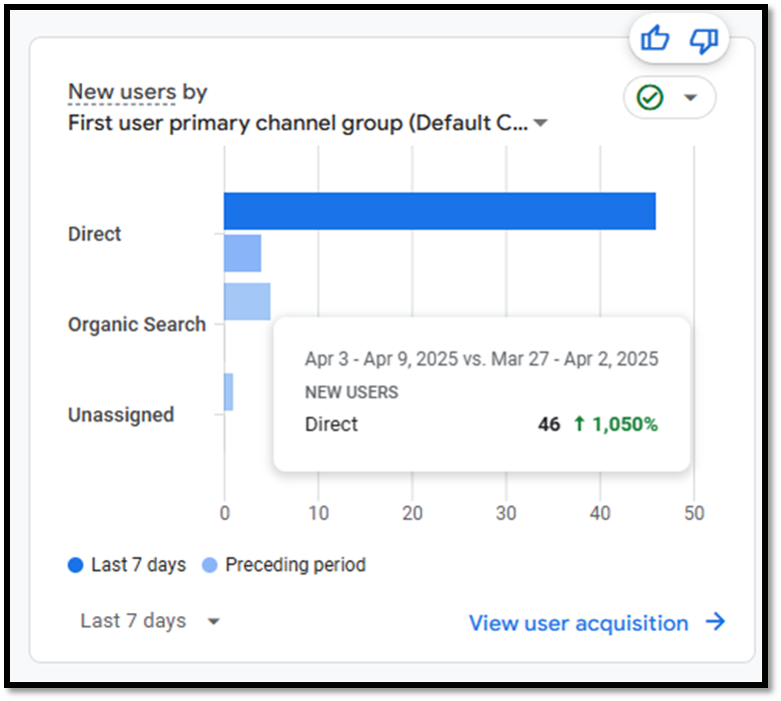
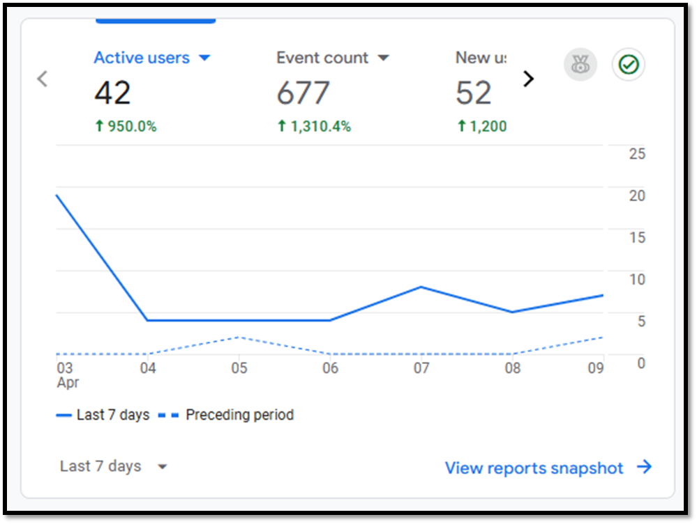
SC DIGITAL MARKETING SERVICES SEO WORK PORTFOLIO
Google Analytics Overview

Slide 13
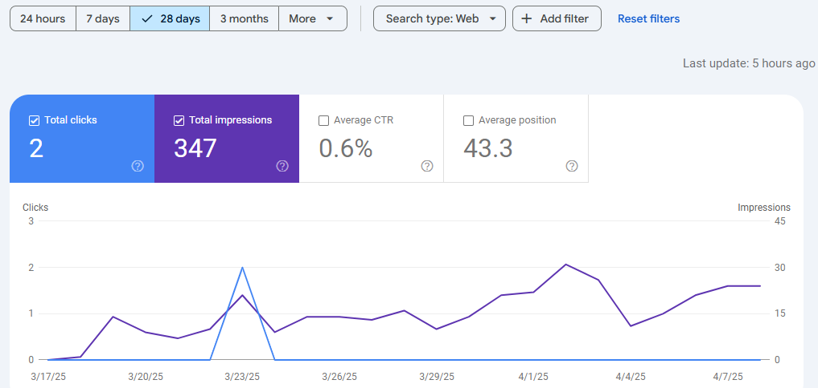
SC DIGITAL MARKETING SERVICES SEO WORK PORTFOLIO
Google Console Overview

Slide 14
SC DIGITAL MARKETING SERVICES SEO WORK PORTFOLIO
Keywords Ranking
https://www.blinx.biz/trusight-eyecare-glaucoma-centre
https://www.brownbook.net/business/53728297/trusight-eyecare-glaucoma-centre/
https://in.enrollbusiness.com/BusinessProfile/7177048/Trusight-Eyecare-Glaucoma-Centre-Mumbai-400051-Maharashtra
https://www.callupcontact.com/b/businessprofile/Trusight_Eyecare_amp_Glaucoma_Centre/9616694
https://www.abnewswire.com/companyname/trusighteyecare.com_156045.html#detail-tab
https://www.saasresearch.com/home-health-software-1/trusight-eyecare-glaucoma-centre
https://www.businesssoftwarehelp.com/solutioneer/trusight-eyecare-glaucoma-centre
https://www.bunity.com/trusight-eyecare-glaucoma-centre
https://www.freelistingusa.com/listings/trusight-eyecare-glaucoma-centre
https://maps.roadtrippers.com/people/TrusightEyecareAndGlaucomaCentre

Slide 15
SC DIGITAL MARKETING SERVICES SEO WORK PORTFOLIO
Keywords Ranking Continued
https://socialsocial.social/user/trusighteyecare/
https://www.localhomeservicepros.com/health-care/trusight-eyecare-glaucoma-centre
http://www.place123.net/place/trusight-eyecare-glaucoma-centre-mumbai-india
https://www.blurb.com/user/trusighteyec?profile_preview=true
https://trusighteyecare.com/the-ultimate-guide-to-glaucoma-treatment-in-mumbai-options-and-care/
https://trusighteyecare.com/clear-vision-ahead-finding-the-right-cataract-specialist-in-mumbai/

Slide 16
SC DIGITAL MARKETING SERVICES SEO PLAN RECOMMENDATIONS
We at SC Digital Marketing Services | Leading Digital Marketing Services in Mumbai | Top Digital Marketing Solutions Provider in Mumbai offer you few recommendations below in terms of SEO Plan to grow your business and add glow to it because we genuinely care about providing service.
In world of AI it is a combination AI SEO and Traditional SEO that can help you business flourish online both in terms of leads converting into revenue and branding
Content Strategy has become more important with the Rise of AI Tools in 2025. Hence using tactics such as SEO Semantic and Content Marketing Funnel has become necessary.
In terms of AI SEO + Traditional SEO as well as Content Strategy we at SC Digital Marketing Services one of the Best Digital Marketing Solutions Provider in Mumbai offer you both to help your business blossom like a flower in the digital garden called ‘Google’ and earn not just revenue but get branding as well.

Slide 17
THE END
To know more about the digital marketing services we at SC Digital Marketing Services offer please call +919619523965, email us at sc05digital@gmail.com or visit us at www.scdigitalmarketingservices.com

